Slide 1
Data Valorization
Alberto García, Meng Li, Yassmin Zouarhi

Slide 2
Reasons of choosing Softmax Method
Softmax is effective for weather classification because:
The problem is multiclass.
Weather categories (sun, rain, fog, drizzle, etc.) are multiple classes, and softmax is designed to model the probability of each class.
It outputs probabilities.
Softmax converts linear scores into probabilities between 0 and 1, and all probabilities sum to 1.
Classes compete with each other.
If the probability of one weather type increases, the probabilities of the others decrease, which matches real-world situations where only one weather category occurs at a time.
It is a natural extension of logistic regression.
Logistic regression works for binary classification, and softmax generalizes it to multiple classes.

Slide 3
Also, we don’t choose the Naive Bayes method because the conditional probability of features are not independent, so it would not be a good choice in this study.
So, softmax provides a mathematically consistent and interpretable way to predict weather categories from features like temperature, precipitation, wind, and month.

Slide 4
Data Preparation
As mentioned in the first part, the final selected variables for our study are maximum temperature, wind speed, precipitation, and date.
Specially, for the data of date, we converted into the data of month to better use the information included.
Besides, we have checked that we don’t have any missing values. As for the outliers, since the information in this case of outliers can indicate some extreme situations in weather, we decided to use all of the data.

Slide 5
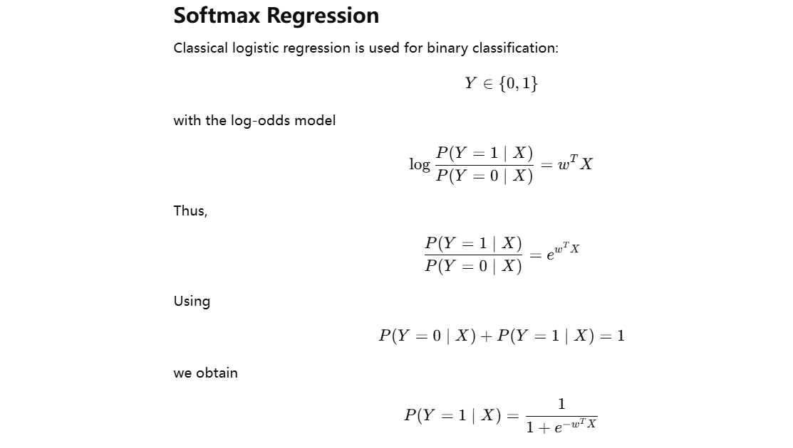
Theoretical Explanation

Slide 6
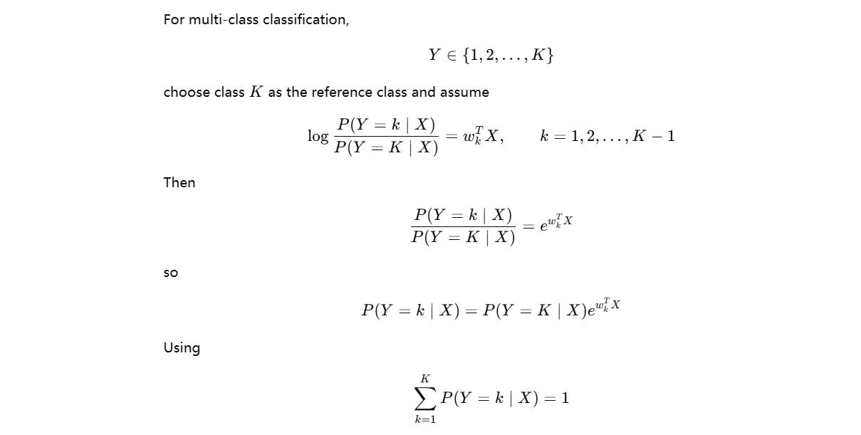

Slide 7
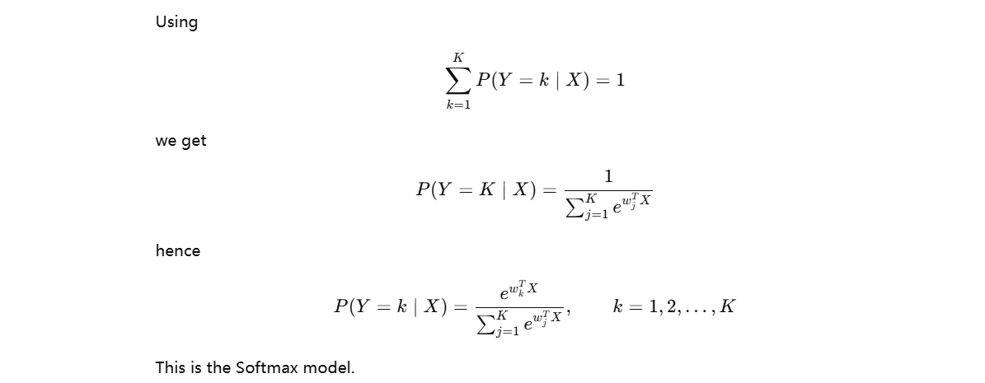

Slide 8
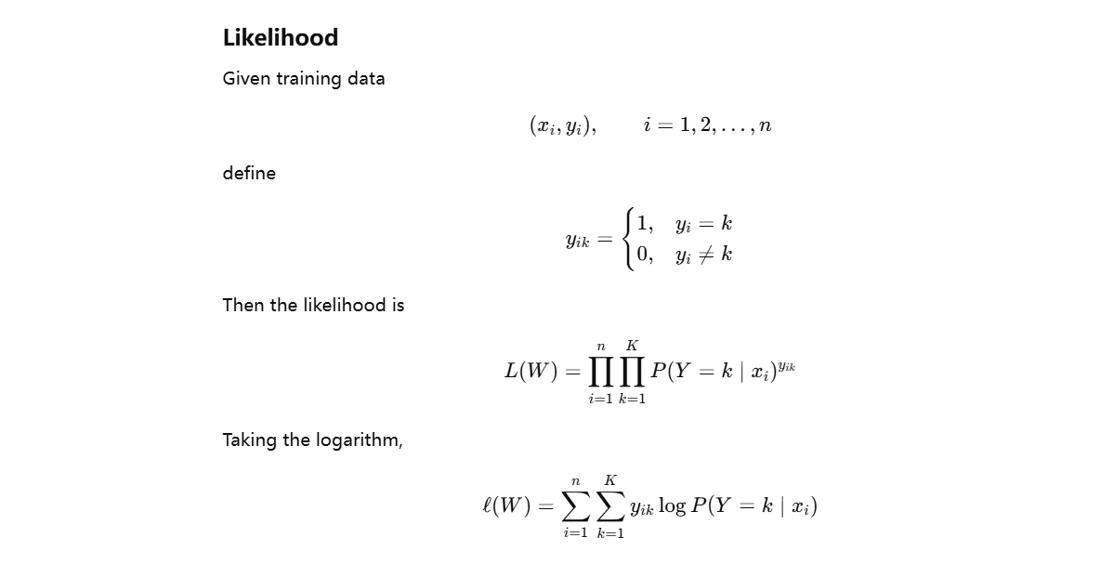

Slide 9
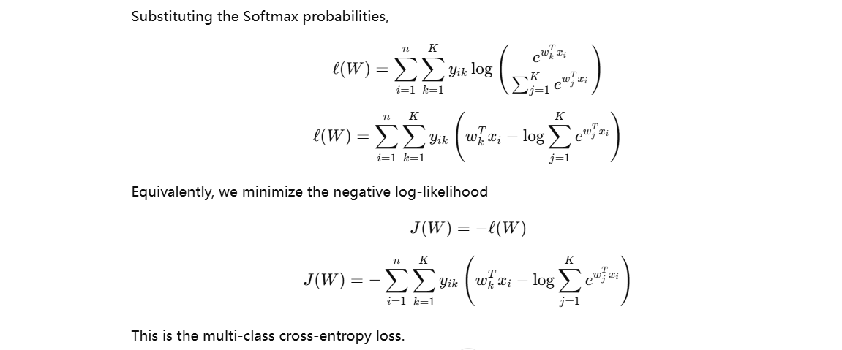

Slide 10
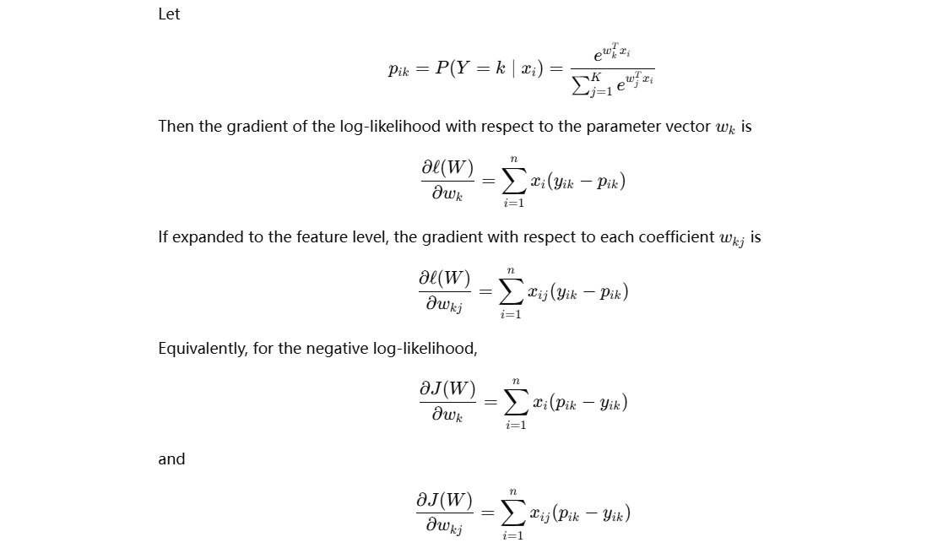

Slide 11
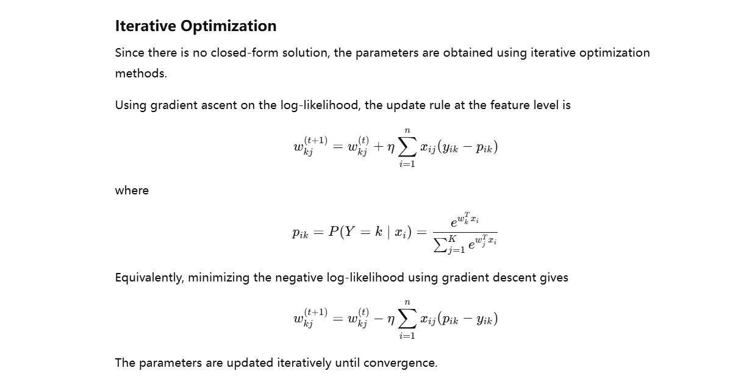

Slide 12
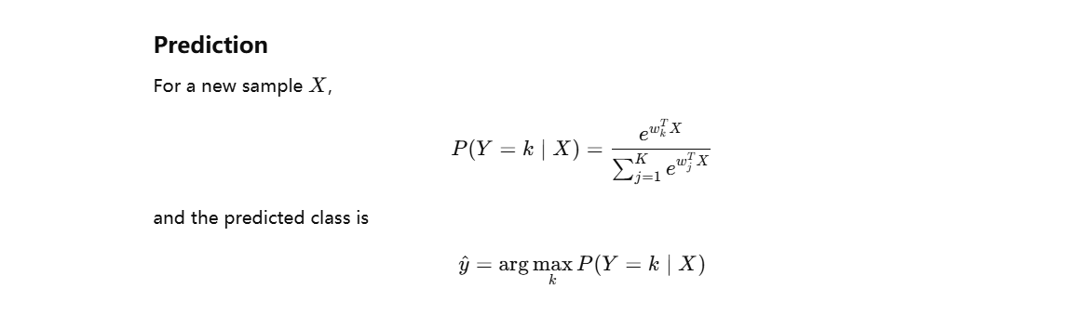

Slide 13
Measure of Performance
To evaluate the performance of the Softmax classification model, we use a confusion matrix and accuracy.
The confusion matrix compares the predicted classes with the true classes and shows how many observations are correctly or incorrectly classified for each category.
The accuracy measures the proportion of correctly predicted observations among all observations. A higher accuracy indicates better classification performance of the Softmax model.

